Slide 1
Abnormal Psychology Part 2
(had to split it because the file was to large to upload)

Slide 2
Schizophrenic Disorders
About 1 in every 100 people are diagnosed with schizophrenia.
Symptoms of Schizophrenia
Disorganized thinking.
Disturbed Perceptions
Inappropriate Emotions and Actions

Slide 3
Disorganized Thinking
The thinking of a person with Schizophrenia is fragmented and bizarre and distorted with false beliefs.
Disorganized thinking comes from a breakdown in selective attention.- they cannot filter out information.

Slide 4
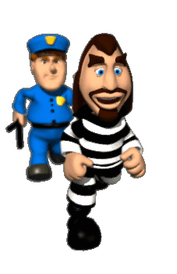
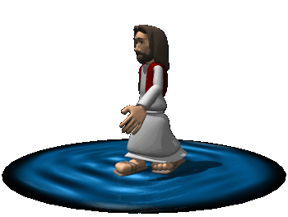
Delusions (false beliefs)
Delusions of Persecution – believing someone’s out to get you
Delusions of sin or guilt – falsely believing you are responsible for some misfortune
Delusions of Grandeur – believing you are more important that you really are.
Delusions of influence – believing you are being controlled by outside forces.

Slide 5
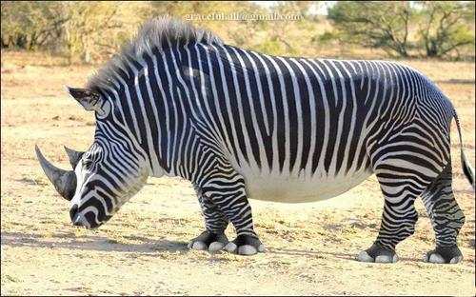
Disturbed Perceptions
hallucinations- a false perception where one has sensory experiences without sensory stimulation.
Can be auditory or visual

Slide 6
Inappropriate Emotions and Actions
Laugh at inappropriate times.
Flat Effect
Senseless, compulsive acts.
Catatonia- motionless Waxy Flexibility/ don’t speak or move for extensive periods of time.

Slide 7
Positive v. Negative Symptoms
Positive Symptoms
Presence of inappropriate symptoms
Negative Symptoms
Absence of appropriate ones.

Slide 8
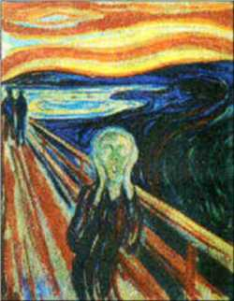
Types of Schizophrenia

Slide 9
Disorganized Schizophrenia
disorganized speech or behavior, or flat or inappropriate emotion.
Clang associations – association of words based on sounds rather than concepts.
Ex: "Imagine the worst Systematic, sympathetic Quite pathetic, apologetic, paramedic Your heart is prosthetic"

Slide 10
Paranoid Schizophrenia
preoccupation with delusions or hallucinations, particularly delusions of grandeur or persecution.
Somebody is out to get me!!!!

Slide 11
Catatonic Schizophrenia
Flat effect
Waxy Flexibility
parrot like repeating of another’s speech and movements
Catatonic excitement- rapid movement, delusions, and hallucinations, followed by catatonic stupor – little activity or speech.

Slide 12
Undifferentiated Schizophrenia
Many and varied Symptoms associated with schizophrenia, but can’t be classified in other categories.

Slide 13
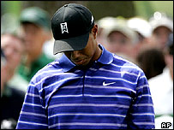
Other Disorders found in the DSM- IV.
Paraphilias – sexual desire for inanimate objects
Pedophilia – sexual desire for small childresn
Zoophilia – sexual desire for animals
Hybristophilia- sexual desire for people who commit greusome acts of violence.
Fetishism- obsessive fascination with an object or body part
Sadist – enjoys inflicting pain on others
Masochist – enjoys the sensation of pain, or having pain inflicted upon them.
Eating Disorders – anorexia, bulimia, obesity
Substance use/abuse disorders
ADHD
Note that some things in the DSM are quite common, while others are much more rare.

Slide 14
The Rosenhan Study
Rosenhan’s associates were Malingering symptoms of hearing voices.
They were ALL admitted for schizophrenia.
None were exposed as imposters.
They all left diagnosed with schizophrenia in remission.
Cause doctors to use further scrutiny when diagnosing and analyzing patients.

Slide 15
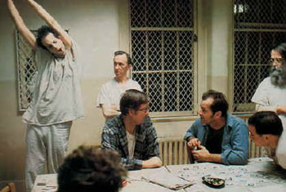
Therapy
In the old days, if someone exhibited abnormal behavior, they were institutionalized.
Because of new medications and better therapy, the U.S. went to a policy of deinstitutionalization.

Slide 16
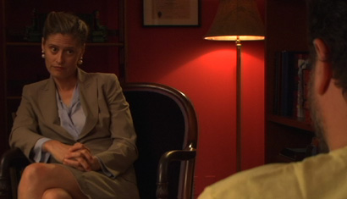
Psychoanalytic Therapy
Psychoanalysis (manifest and latent content through…. hypnosis free association, dream, interpretation).
Unconscious
Transference
Other therapies will result in symptom substitution.

Slide 17
Humanistic Therapy
Client-Centered Therapy by Carl Rogers
These are non-directive therapies (client centered) and use active listening.
Self-actualization, free-will and unconditional positive regard.
Gestalt Therapy by Fritz Perls encourage clients to get in touch with whole self.

Slide 18
Behavioral Therapies
Counter-conditioning
Classical Conditioning
Aversive Conditioning
Systematic desensitization
Flooding
Operant Conditioning
Token Economy

Slide 19
Cognitive Therapy
Change the way we view the world (change our schemas)
Aaron Beck
Albert Ellis and Rational Emotive Therapy

Slide 20
Somatic Therapies
Psychopharmacology – adjusting chemical imbalances in the brain.
Antipsychotics (thorazine, haldol)
Anti-anxiety (valium, barbiturates, Xanax)
Mood Disorders (serotonin reuptake inhibitors)
Bipolar (lithium)

Slide 21
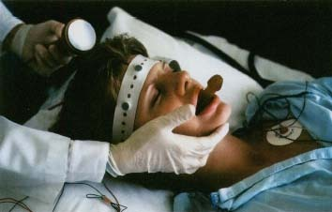
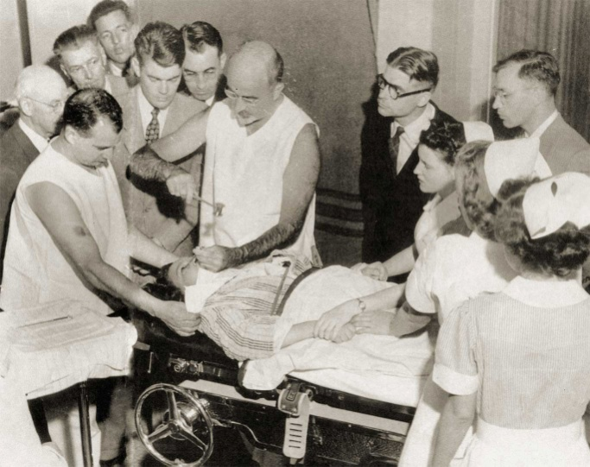
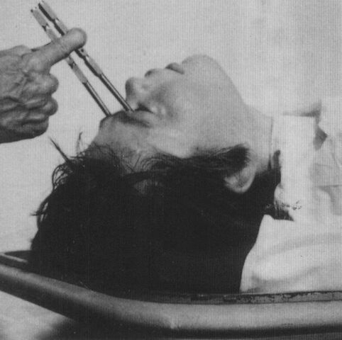
Somatic Therapy
Electroconvulsive Therapy (ECT)- for depression. (used in the past)
Psychosurgury
Prefontal lobotomy

Slide 22
Group Therapy
Often comprised of several patients in different stages of the treatment process.
Shared experiences
Helps build socialization and coping skills.

